Slide 1
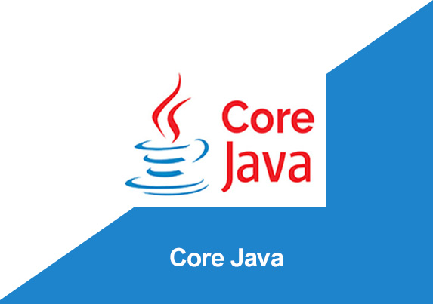
By: Manas Tuwani

Slide 2
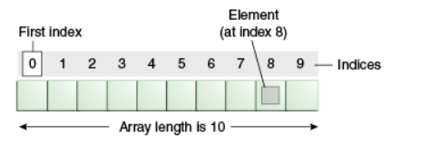
Java Arrays
An array is a collection of similar types of data.
Java array is an object which contains elements of a similar data type. Additionally, The elements of an array are stored in a contiguous memory location. It is a data structure where we store similar elements. We can store only a fixed set of elements in a Java array.
Array in Java is index-based, the first element of the array is stored at the 0th index, 2nd element is stored on 1st index and so on.

Slide 3
Java Arrays
An array is a collection of similar types of data.
For example, if we want to store the names of 100 people then we can create an array of the string type that can store 100 names.
String[] arr = new String[100]
Here, the above array cannot store more than 100 names. The number of values in a Java array is always fixed.
Arrays are used to store multiple values in a single variable, instead of declaring separate variables for each value.
To declare an array, define the variable type with square brackets:

Slide 4
How to declare an array in Java?
In Java, we can declare an array:
Datatype[ ] array name;
Datatype: It can be primitive data type like int, short, double, char etc.
Array name: It is an identifier.
For example: double[ ] arr;

Slide 5
Syntax to Declare an Array in Java
dataType[] arr; (or)
dataType []arr; (or)
dataType arr[];
Memory Allocation
arr = new int[10];
Declaration and Allocation
Int[] arr =new int[100];

Slide 6
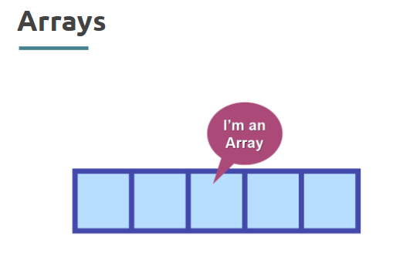
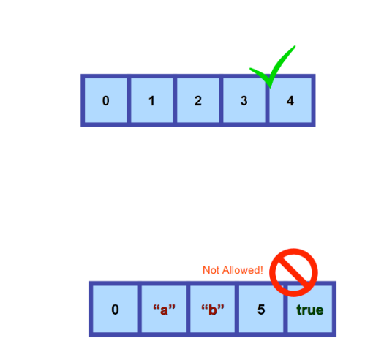
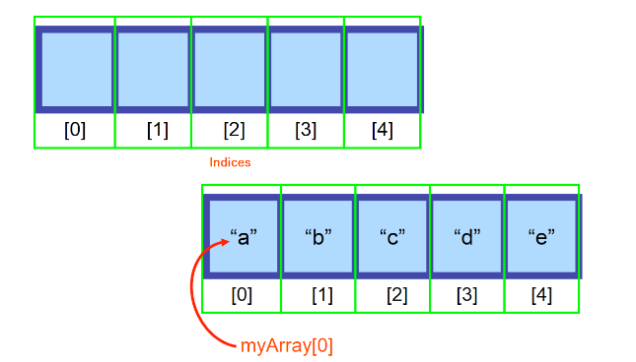


Slide 7

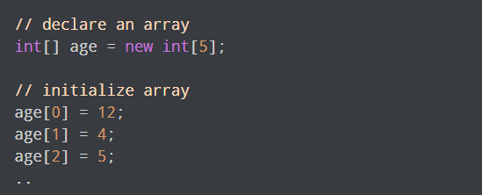
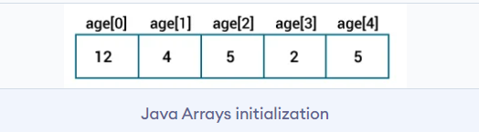
How to Initialize Arrays in Java?
In Java, we can initialize arrays during declaration. For example,
// Declare and initialize the array:
Int[] age = {12, 4, 5, 2,5};

Slide 8

How to Access Elements of an Array in Java?
We can access the element of an array using the index number. Here is the syntax for accessing elements of an array

Slide 9
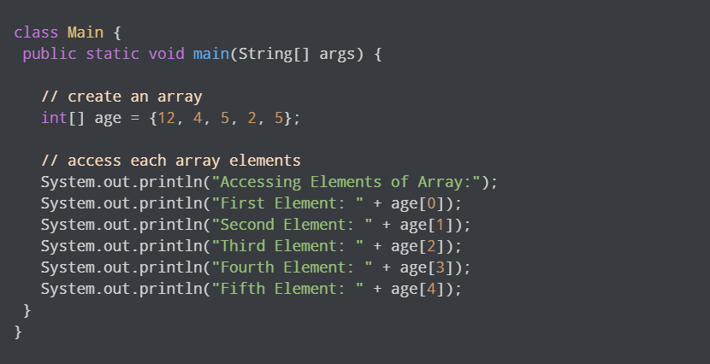
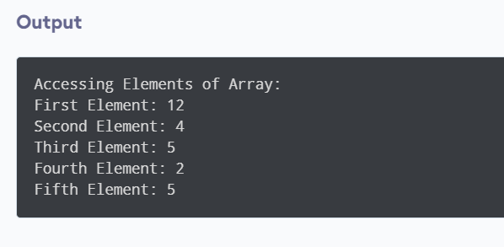
Example: Access Array Elements

Slide 10
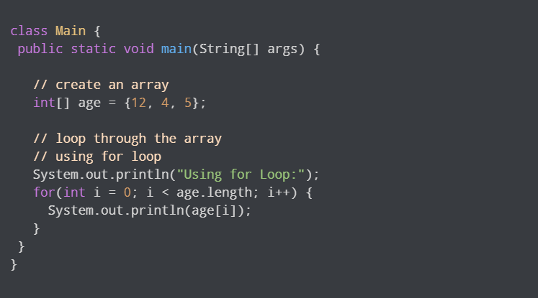
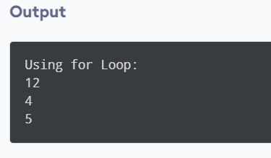
Looping Through Array Elements
In Java, we can also loop through each element of the array. For example:

Slide 11
For-each Loop for Java Array
We can also print the Java array using for-each loop. The Java for-each loop prints the array elements one by one. It holds an array element in a variable, then executes the body of the loop.
The syntax of the for-each loop is given below:
for(datatype variable : array) {
//body of the loop
}

Slide 12
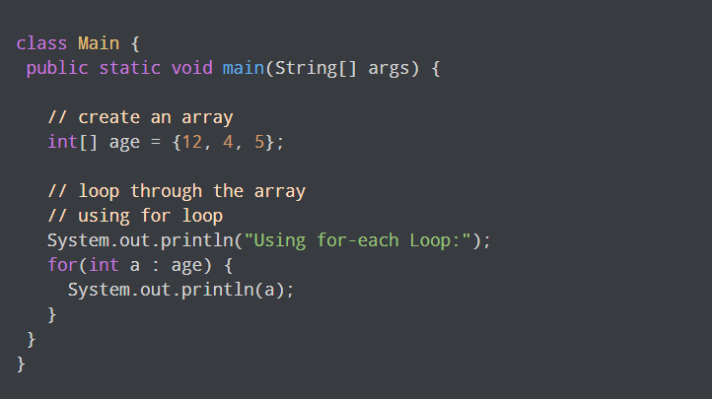
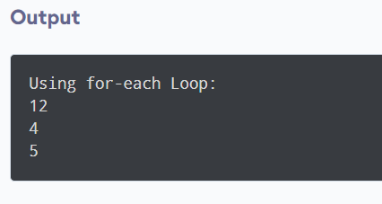
Example: Using the for-each Loop

Slide 13
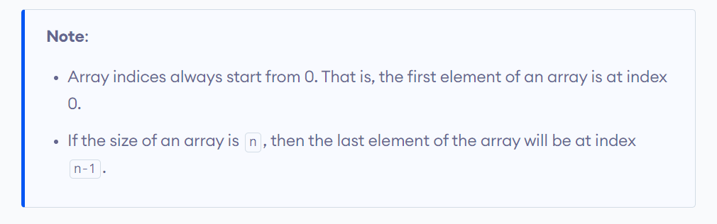

Slide 14
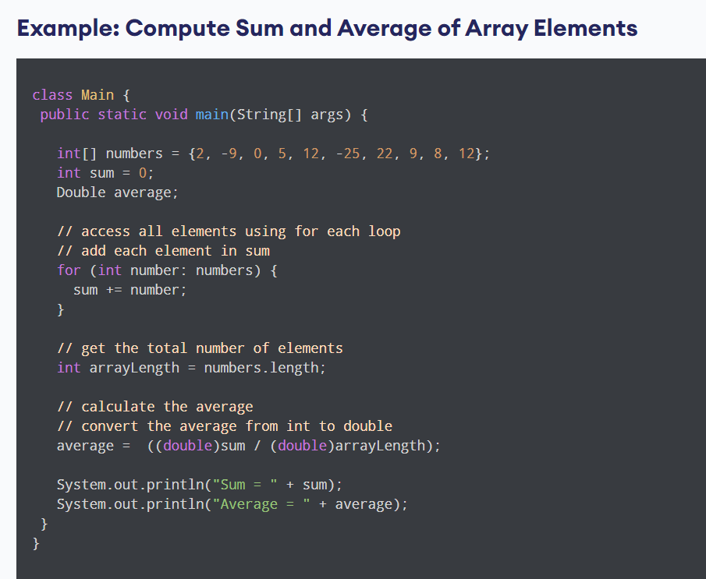
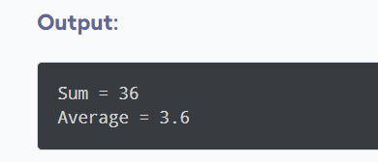

Slide 15
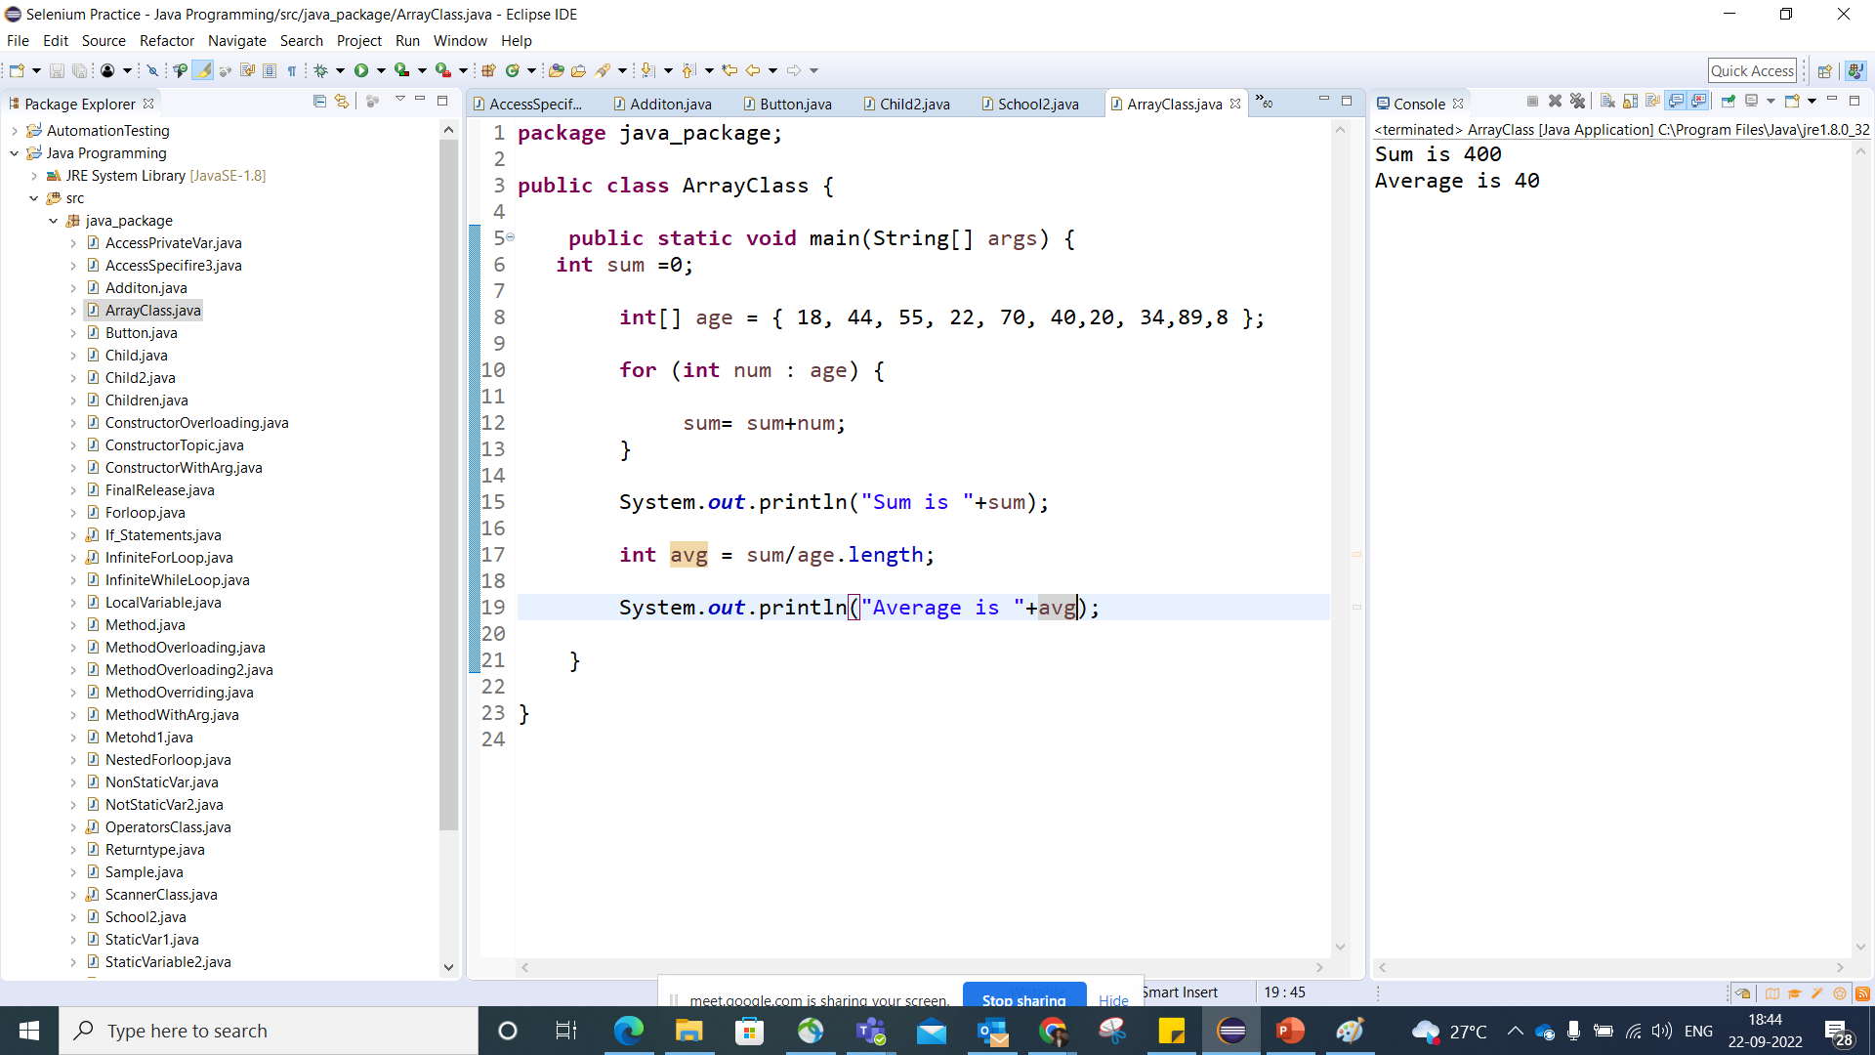

Slide 16
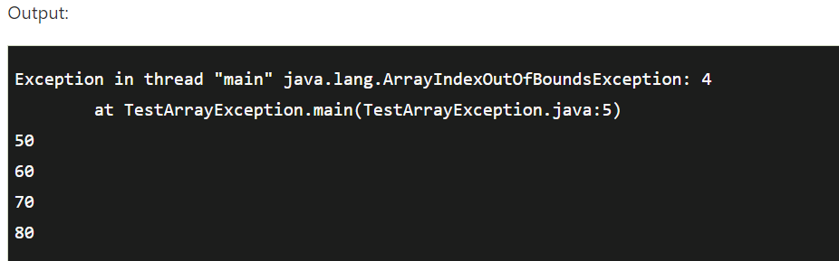
ArrayIndexOutOfBounds Exception
The JAVA throws an ‘ArrayIndexOutOfBoundsException’ if length of the array in negative, equal to the array size or greater than the array size while traversing the array.
/ArrayIndexOutOfBoundsException in a Java Array.
public class TestArrayException{
public static void main(String args[]){
int arr[]={50,60,70,80};
for(int i=0;i<=arr.length;i++){
System.out.println(arr[i]);
}
}
}

Slide 17
Advantages
Code Optimization: It makes the code optimized, we can retrieve or sort the data efficiently.
Random access: We can get any data located at an index position.

Slide 18
Disadvantages
Size Limit: We can store only the fixed size of elements in the array. It doesn't grow its size at runtime. To solve this problem, collection framework is used in Java which grows automatically.
Datatype Limit: As per the definition of arrays, they can only store data of a single type.

